Slide 1
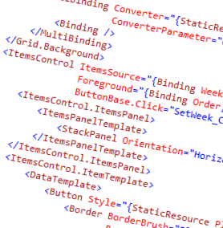
WPF and XAML
2.0 – Panel Based Layout

Slide 2
Overview
What is a panel?
Canvas
Grid
StackPanel

Slide 3










Panels

Slide 4
Canvas
Children are explicitly places relative to upper left
No automatic resizing
Canvas.Top and Canvas.Left attached properties specify child location
Left
0,0
10,10 100,10
50,30
Top

Slide 5
Grid
Defines a grid of specific number of rows and columns
Width and height of rows can be specified, but otherwise sizes adapt to the containing control
Children placed in cells with attached properties Grid.Row and Grid.Column
Children can have spans: Grid.ColumnSpan, Grid.RowSpan
Very flexible
Likely the most common layout panel
A lot like HTML <table>
Columns
(0,0)
(0,1)
Rows
(1,0)
(1,1)

Slide 6
Stack Panel
Place children in horizontal or vertical stacks
Fairly flexible in sizing of items
Children are placed using logic contained in the StackPanel
Probably the second most used panel
1
2
3
4
1
2
3
4

Slide 7

Width (px)
Height (px)

Slide 8








▪
Stretch (default)
Left

Slide 9





▪
Stretch (default)
Top

Slide 10





▪
▪
Stretch (default)

Slide 11



▪
▪
Stretch (default)

Slide 12





















Two-pass recursive process: Measure then Arrange
Objects request a size, but may not be given it
The real size after layout is ActualWidth / ActualHeight

Slide 13
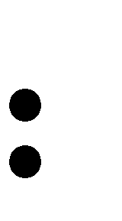



Shop
Address
Street
Country
List of Products
For each Product
Name
Price

Slide 14






<StackPanel>
<Button Content="Hi there!" />
</StackPanel>
StackPanel
Button
Other…

Slide 15

<Button>
<TextBlock Text="Hi there!" />
</Button>
Button
ContentPresenter
TextBlock
<Button.Template>
<ControlTemplate TargetType='Button'>
<ContentPresenter ... />
</ControlTemplate>
</Button.Template>

Slide 16

<RichTextBox>
<FlowDocument>
<Paragraph>
Hello <Image ... />
</Paragraph>
</FlowDocument>
</RichTextBox>
RichTextBox
Image

Slide 17
Summary
Three primary panels: Canvas, Grid, StackPanel
Canvas and Grid use attached properties to position children
StackPanel controls placement and sizing by its own rules
Remember there are object and visual trees

Slide 18
Demo
Demonstrate Canvas, Grid, StackPanel

Slide 19
Lab
Create a grid and place children in various cells
Put a stack panel with multiple items in a given grid cell

